Slide 1
Quarantine & Stress Levels
Analysis by Kyle Reep

Slide 2
Comparisons
Quarantine was stressful, to most
Mental Health affected
Career changes/loss
Stir crazy in homes
Federal economic issues

Slide 3

Which one affected/was affected by which?

Slide 4

Stress Levels v. Days indoors​
Too much time at home for everyone?

Slide 5
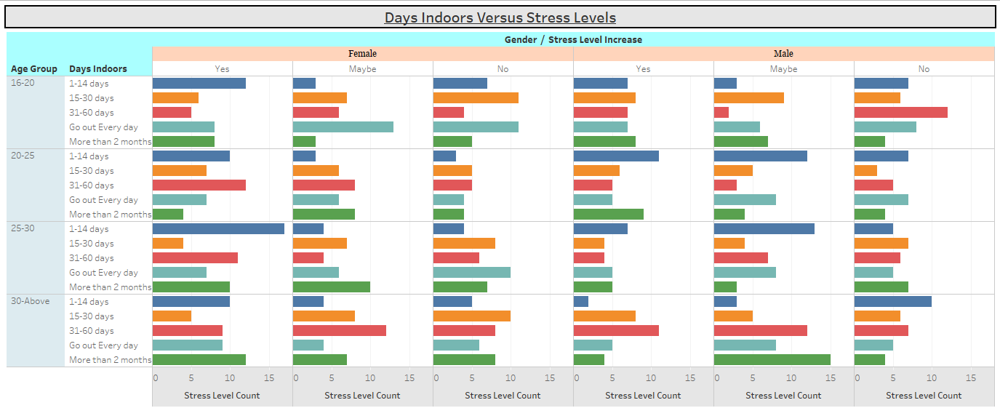
Stress Levels v. Days indoors
Females experiencing more stress at home overall
Males reportedly indecisive, but mostly in first 2 weeks of federal quarantine
Positive Correlation between datasets (0.89)

Slide 6
Stress Levels V. Occupation
A career change is often life-altering

Slide 7
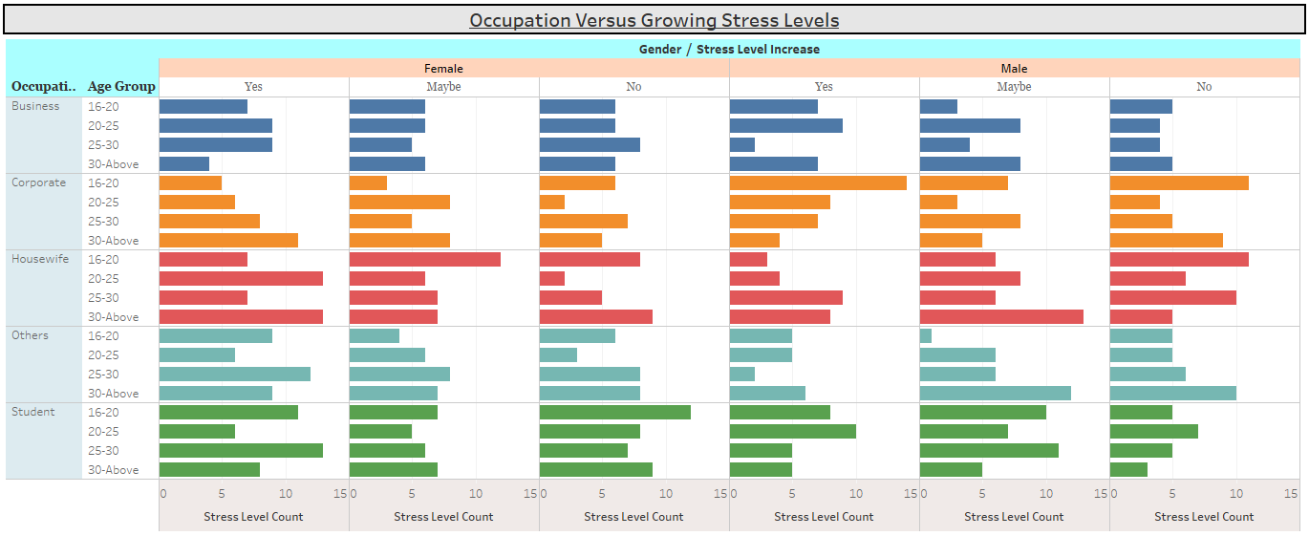
Stress Levels V. Occupation
Females experiencing more stress with their occupations as a whole
Males disproportionately concerned in corporate positions
Positive Correlation between datasets (0.73)

Slide 8

Stress Levels V Occupation (Cont.)
Females seem to be more stressed regarding occupation
Potential biases at workplace
Often responsible for home/childcare and occupation as well
Males were more concerned in corporate positions and less so in all other positions listed:
Economic ruin for businesses large and small​
Other jobs typically secure for males
Hopeless confidence or lack of conviction?
8

Slide 9

Stress Levels V Mental Health History
Does the history of one’s mental health affect how they view current events?
Disclaimer: Mental Health History is self reported here and is not in any way endorsed or supported by a medical professional

Slide 10
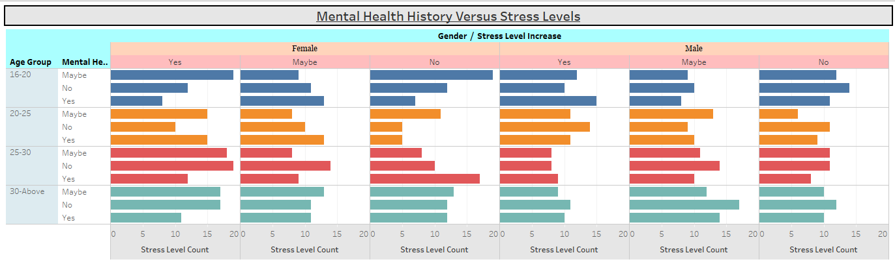
Stress Levels V Mental Health History
Extremes in both Yes and No for younger individuals
Weak but positive r squared correlation coefficient (0.59)
Unlikely that mental health history correlates with stress levels

Slide 11
Final Quarantine takeaways​
Fairly Consistent Results
Steady increase in stress related to external factors
Days Indoors
More time at home led to more stress for all ages
Occupation​
Corporate/Economic positions at high stress risk
Mental Health History
Stress increased steadily regardless of mental health history
All data opinionated
Stress increased significantly more for younger generations
Anonymous entries used for bias elimination
Deeper Meanings behind stress levels
Potential political affiliation causes

Slide 12
Credit and Attributions:
- Link to Mental Health Dataset: https://data.mendeley.com/datasets/pxjmjyfdh2/2
- Tableau Professional Desktop Edition used for data visualization
- SSMS Used for SQL compilations, Data cleaning, and Navigation
Disclaimer: I do not claim to own, have gathered, or been a part of any of the data in the dataset used for this analysis. All credit goes to the original owners of any part of this project. Unauthorized distribution of this project or any data therein for any use is prohibited without a valid disclaimer and attribution to the original creators. I am not liable for any misuse or violation associated with the data in question or its owners

Slide 13
THANK YOU
Kyle Reep
555-555-5555
myemailhere@butnotforgithub.com​
www.mycompanywebsite.com

